Slide 1
Title: High-Volume Client Retention Strategy
A Case Study in Operational Autonomy & Account Management Name: Katlego Matlabe Date: 2019-2024

Slide 2
The Scope
Title: Managing a Global Portfolio of 5,600+ Accounts Contents:
The Challenge: Managing a high-velocity client base across multiple time zones with zero direct supervision.
The Objective: Maximize session volume while maintaining a >4.8/5 satisfaction rating and minimizing churn.
The Environment: 100% Remote, Independent Contractor model requiring self-managed scheduling, technical troubleshooting, and conflict resolution.

Slide 3
The Methodology
Title: The "Trusted Advisor" Framework Content: To manage 11,000+ sessions effectively, I implemented a three-pillar success strategy:
Rapid Onboarding: Established rapport within the first 60 seconds to reduce "early-stage drop-off.“
Customized Success Plans: Moved clients from ad-hoc sessions to structured development plans, increasing Customer Lifetime Value (CLV).
Cultural Adaptability: Adjusted communication styles for clients across Asia, Middle East, North Africa, Europe, and South America to ensure clarity and comfort.

Slide 4
Key Performance Metrics
Title: Performance at Scale (2019–2024) Content:
Total Unique Accounts Managed: 5,619
Total Sessions Completed: 11,263
Total Service Hours: ~5,289
Reliability Rate: 99.9% attendance on scheduled bookings.
Transcription Accuracy (Rev.com): 98% (Verifiable metric of attention to detail).

Slide 5
Churn Prevention Scenario
Title: Case Study: Re-engaging "At-Risk" Clients Content:
The Issue: A long-term client expressed frustration with lack of progress and signaled intent to cancel (churn).
The Intervention:
Conducted a "Needs Analysis" to identify the specific gap in their learning path.
Pivoted from general conversation to a structured, metric-based curriculum.
Provided offline resources (PDFs/Articles) to add value between sessions.
The Outcome: Client renewed for an additional 6-month cycle and referred 2 new users.

Slide 6
The Valuation Proposition
Title: Transferable Value to [Company Name]
Content: My background in high-volume education translates directly to Customer Success and GRC:
From Teaching to Onboarding: I know how to explain complex products to non-technical users.
From Grading to Reporting: I am disciplined in documenting interactions and tracking progress (Incident Reports/Logs).
From Freelancing to Ownership: I possess "Operational Autonomy"—I don't need to be micromanaged to hit my targets.

Slide 7
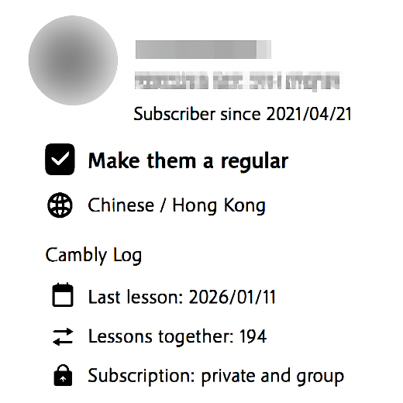
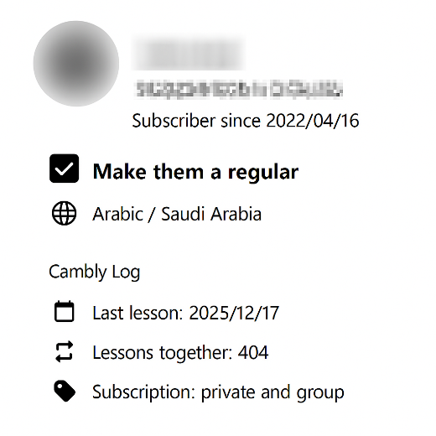
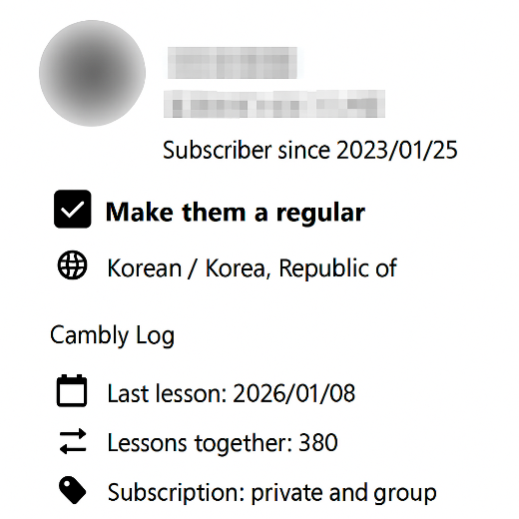
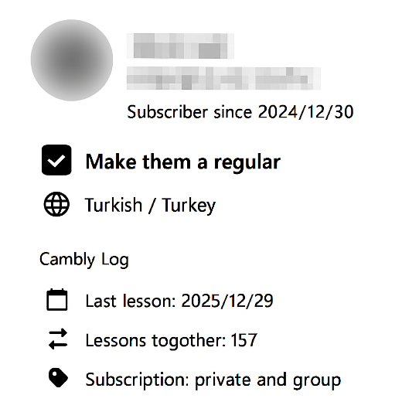
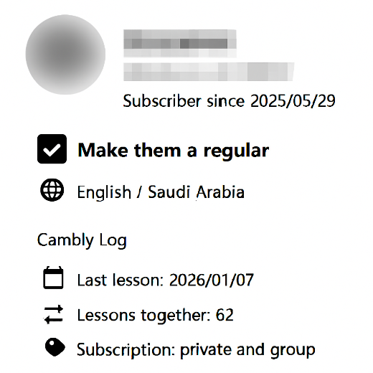
These 4 accounts represent a wider portfolio of 5,600+ users, demonstrating a consistent ability to retain business across diverse demographics and time zones.

